Slide 1
Experiment 5 (Number Converter)
Design a BCD to Excess 3 code converter using combinational circuits.

Slide 2
Excess-3
The Excess-3 binary code is an example of an unweighted and a self-complementary BCD code.
A self-complementary binary code is a code which is always complimented in itself.
The complement of a binary number can be obtained from that number by replacing 0’s with 1’s and 1’s with 0’s.
The sum of binary number and its complement is always equal to decimal 9.
In other words, the 1’s complement of an excess-3 code is the excess-3 code for the 9’s complement of the corresponding decimal number.
For example, the excess-3 code for decimal number 5 is 1000 and 1’s complement of 1000 is 0111, which is excess-3 code for decimal number 4, and it is 9’s complement of number 5.

Slide 3
Excess-3
This property is useful since a decimal number can be nines’ complemented (for subtraction) as easily as a binary number can be ones’ complemented; just by inverting all bits.
For example,
the excess-3 code for 3 (0011) is 0110,
and to find the excess-3 code of the complement of 3,
we just need to find the 1’s complement of 0110 -> 1001,
which is also the excess-3 code for the 9’s complement of 3 -> (9-3) = 6.

Slide 4
Excess-3: Advantages
The primary advantage of excess-3 coding over non-biased coding is that a decimal number can be nines' complemented (for subtraction) as easily as a binary number can be ones' complemented: just by inverting all bits.
Also, when the sum of two excess-3 digits is greater than 9, the carry bit of a 4-bit adder will be set high. This works because, after adding two digits, an "excess" value of 6 results in the sum.
Because a 4-bit integer can only hold values 0 to 15, an excess of 6 means that any sum over 9 will overflow (produce a carry out).
Another advantage is that the codes 0000 and 1111 are not used for any digit.
A fault in a memory or basic transmission line may result in these codes.
It is also more difficult to write the zero pattern to magnetic media.

Slide 5
Converting BCD(8421) to Excess-3 –
As is clear by the name, a BCD digit can be converted to its corresponding Excess-3 code by simply adding 3 to it.
Since we have only 10 digits(0 to 9) in decimal, we don’t care about the rest and marked them with a cross( X ).
Let A, B, C, and D be the bits representing the binary numbers, where D is the LSB and A is the MSB and
Let w, x, y, and z be the bits representing the gray code of the binary numbers, where z is the LSB and w is the MSB.

Slide 6
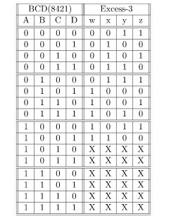
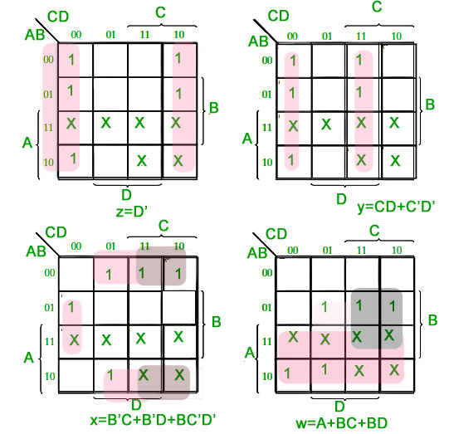
Converting BCD(8421) to Excess-3 –
The truth table for the conversion is given below. The X’s mark is don’t care condition.

Slide 7
Converting BCD(8421) to Excess-3 –
K-maps
Corresponding minimized Boolean expressions for Excess-3 code bits –
w = A + BC + BD x = B'C + B' D + BC'D' y = CD + C'D' z = D'

Slide 8
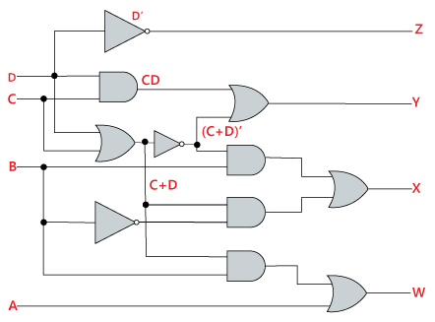
Converting BCD(8421) to Excess-3 –
The truth table for the conversion is given below. The X’s mark is don’t care condition.
w = A + BC + BD x = B'C + B' D + BC'D' y = CD + C'D' z = D'

Slide 9
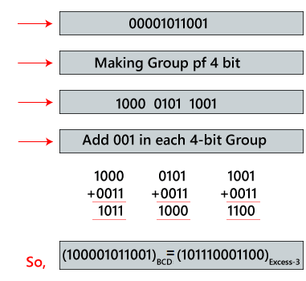
Example
(100001011001)_{BCD}
To find the Excess-3 code of the given BCD code, first, we will make the group of 4 bits from right to left. Then, we will add 0011 in each group of 4 bits in order to get the excess-3 code.
1
Questions: Convert decimal number 23 to Excess-3 code.

Slide 10
Verilog code
module BCD2Ex3(A, B, C, D, W, X, Y, Z);
input A, B, C, D;
output W, X, Y, Z;
assign W = A | (B&C) | (B&D);
assign X = (~B&C) | (~B & D) | (B & ~C & ~D);
assign Y = ~( C ^ D);
assign Z = ~D;
endmodule

Slide 11
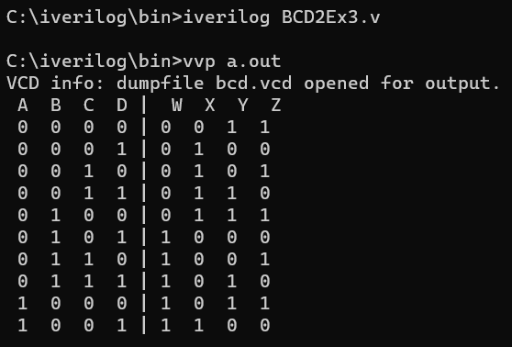
Verilog code
module test;
wire W, X,Y,Z;
reg A,B,C,D;
BCD2Ex3 object(A,B,C,D,W,X,Y,Z);
initial begin
$dumpfile("bcd.vcd");
$dumpvars(0,test);
$display (" A B C D | W X Y Z");
$monitor(" ",A, " ",B, " ",C, " ",D, " | ", W, " ",X, " ",Y, " ",Z);
A = 0; B = 0; C = 0; D = 0;
#5 A = 0; B = 0; C = 0; D = 0;
#5 A = 0; B = 0; C = 0; D = 1;
#5 A = 0; B = 0; C = 1; D = 0;
#5 A = 0; B = 0; C = 1; D = 1;
#5 A = 0; B = 1; C = 0; D = 0;
#5 A = 0; B = 1; C = 0; D = 1;
#5 A = 0; B = 1; C = 1; D = 0;
#5 A = 0; B = 1; C = 1; D = 1;
#5 A = 1; B = 0; C = 0; D = 0;
#5 A = 1; B = 0; C = 0; D = 1;
end
endmodule

Slide 12
Solve:Excess-3 to BCD conversion
Decimal Number | Excess-3 Code |  |  |  | BCD Code
 | A | B | C | D | W | x | y | z
0 | 0 | 0 | 0 | 0 | X | X | X | X
1 | 0 | 0 | 0 | 1 | X | X | X | X
2 | 0 | 0 | 1 | 0 | X | X | X | X
3 | 0 | 0 | 1 | 1 | 0 | 0 | 0 | 0
4 | 0 | 1 | 0 | 0 | 0 | 0 | 0 | 1
5 | 0 | 1 | 0 | 1 | 0 | 0 | 1 | 0
6 | 0 | 1 | 1 | 0 | 0 | 0 | 1 | 1
7 | 0 | 1 | 1 | 1 | 0 | 1 | 0 | 0
8 | 1 | 0 | 0 | 0 | 0 | 1 | 0 | 1
9 | 1 | 0 | 0 | 1 | 0 | 1 | 1 | 0
10 | 1 | 0 | 1 | 0 | 0 | 1 | 1 | 1
11 | 1 | 0 | 1 | 1 | 1 | 0 | 0 | 0
12 | 1 | 1 | 0 | 0 | 1 | 0 | 0 | 1
13 | 1 | 1 | 0 | 1 | X | X | X | X
14 | 1 | 1 | 1 | 0 | X | X | X | X
15 | 1 | 1 | 1 | 1 | X | X | X | X

